Slide 1


Department of
Computer Science and Engineering
COMPUTER GRAPHICS AND IMAGE PROCESSING
Faculty Name : S.KIRUTHIGA
School of Computing
Vel Tech Rangarajan Dr. Sagunthala R&D Institute of
Science and Technology

Slide 2


UNIT-4
COLOR MODELS AND SEGMENTATION

Slide 3
Course Outcome
CO4-Summarize in Basic of Image Processing

Slide 4
PREFACE
Color Model
RGB-CMYK-HSV
Watersheds and Minimum spanning tree
Livewires/Intelligent scissors
Active Contours-DP snakes

Slide 5


Slide 6

A color model is a specification of a 3D color co-ordinate system and a visible subset in the co-ordinate System within all colors in a particular color range lie.
There are main four types of color models:-
RGB
CMY
CMYK
YIQ
This four models are hardware oriented color models.

Slide 7


But these models are not easy to use because they does not relate directly to intuitive color notations of hue,saturation and brightness.
Therefore another class of color model has been developed.
These includes :- HSV
HLS HVC
The human eye can perceive about 382000(!) different colors.
The distance between two color in the color cube is not a measure.

Slide 8
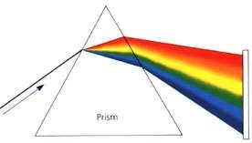
White light consists of a spectrum of all visible colors.
All kinds of light can be described by the energy of each wavelength.

Slide 9
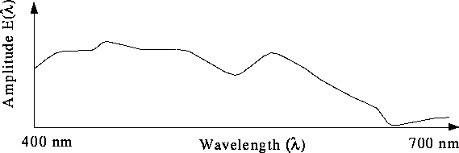
Most light we see is not just a single wavelength, but a combination of many wavelengths like below. This profile is often referred to as a spectrum, or spectral power distribution.

Slide 10

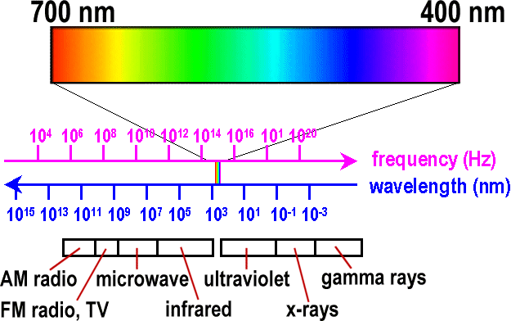
Frequency:
Red: 3.8x10¹⁴ hertz
Violet: 7.9x10¹⁴ hertz
Wavelength:
Red: 700 nm
Violet: 400 nm

Slide 11

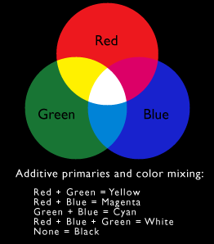
When we combine
Red(two-thirds), Green(two-third), Blue(one-third)
then we can get WHITE color.
But we can absorbs CMY color from this RGB color then we can get BLACK color

Slide 12
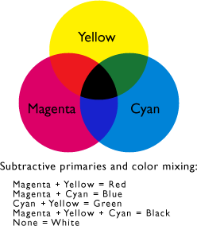
When we combine
CYAN, MAGENTA, YELLOW
then we can get BLACK color.
But we can absorbs RGB color from this CMY color then we can get WHITE color.

Slide 13

Color mixing created by an artist.
Shades, tints and tones in scene can be produced by mixing color pigments (hues) with white and black pigments.
Shades:
Add black pigment to pure color
The more black pigment, the darker the shade
Tints:
Add white pigment to the original color
Making it lighter as more white is added
Tones:
Produced by adding both black and white pigments

Slide 14
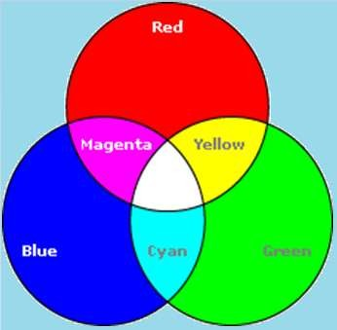
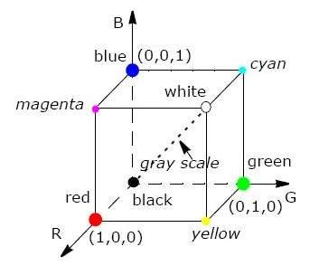
The RGB color model used in color CRT monitors.
In this model,
Red,Green and Blue are added together to get the resultant color WHITE.

Slide 15

Each color point within the bounds of the cube is represented as the triple (R,G,B).where value for R,G,B are assigned in the range from 0 to 1.
Here RGB color place together at 120 degree. RED + GREEN + BLUE = WHITE(contribute)
All other colors are generated from these three primary colors.

Slide 16





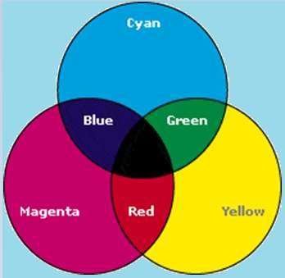
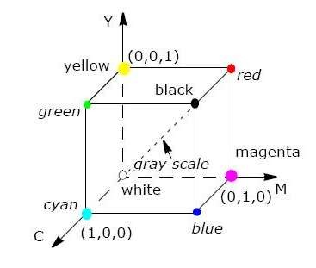
The CMY color model used in color printing devices.
In this model,
Cyan,Magenta and Yellow are added together to get the resultant color BLACK.

Slide 17
Each color point within the bounds of the cube is represented as the triple (C,M,Y).where value for C,M,Y are also assigned in the range from 0 to 1.
Here CMY color also place together at 120 degree. CYAN+ MAGENTA + YELLO = BLACK(contribute)
All other colors are generated from these three primary colors.

Slide 18


If the intensities are represented as 0≤r,g,b≤1 and 0≤c,m,y≤1 then the relation between RGB and CMY can be described as:
 c  1  r
_{m}  ₁  _{g}
⎜_{⎝ y} ⎟⎠ ⎜⎝ ⎟⎠ ⎜⎝ ⎟⎠
1 b

Slide 19
For printing & art industry the CMY model is not enough. So,Fourth primary color K is added to CMY model.
K stands for BLACK color.

Slide 20
The YIQ color model is a recoding of RGB color model.
YIQ color model is used for television broadcasting. The
Y-channel contains luminance information(sufficient for Black
& White television sets) And
I-channel & Q-channel contains color information.
For recoding RGB to YIQ , HSV & HLS color models are used.
Inphase = RED – YELLOW Quadrature = BLUE – YELLOW

Slide 21
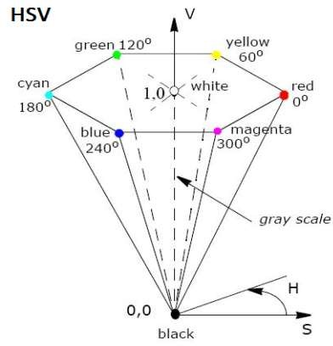
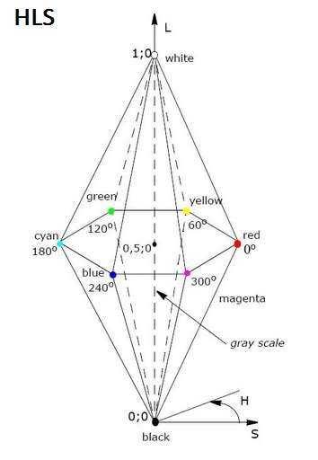
HSV and HLS are the two most common cylindrical- coordinate representations of points in an RGB color model.
HSV is described by a hexacone derived from the RGB cube.

Slide 22


Hue means color is mapped into 0-360’.The wavelength of Hue is 128.
Saturation is defined into 0-1.In this the amount of WHITE color is 130.
Value is defined into 0-1.In this the amount of BLACK color is 23

Slide 23


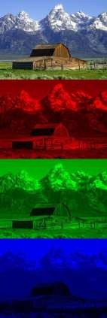
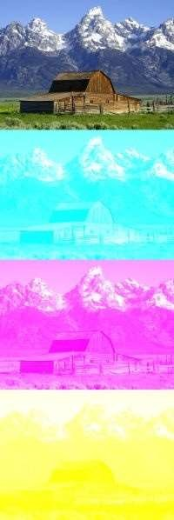
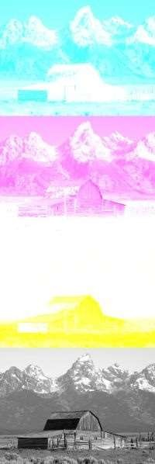
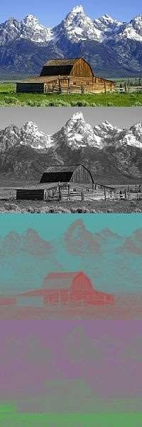
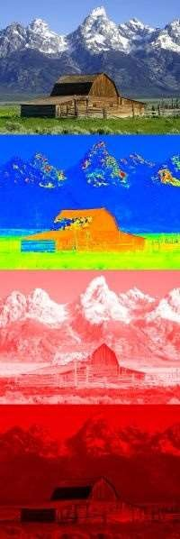
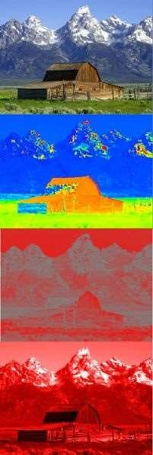
RGB
CMY
CMYK
YIQ
HSV
HLS

Slide 24
Application
The RGB model is widely used in the representation and display of images in electronic systems like computers and televisions.
It is also used in conventional photography as well.
Image scanner which scans images and converts it to a digital image mostly supports RGB color.
It is used in web graphics.

Slide 25
Active Contours

Slide 26
Introduction
Active contours, also known as snakes, is a framework for getting object outline contour.
The framework minimizes an energy associated to the current contour as a sum of internal and external energies
External energy expression is derived such that it is minimum at object boundary
Internal energy regulates the shape of contour, controlling its curvature, shape regularity, etc.
More energy terms can be introduced as per user application such as initializing multiple snakes and defining attraction energy between them, etc.

Slide 27
Advantages & Limitations
Advantages of snakes
Autonomous and self-adapting in their search for minimal energy
Can track moving objects in temporal as well as spatial direction
Custom energies can be defined to enhance contour evolution
Limitations of snakes
Can get stuck in local minima states
Can miss minute features in the process of minimizing whole contour energy
May require higher computation time

Slide 28
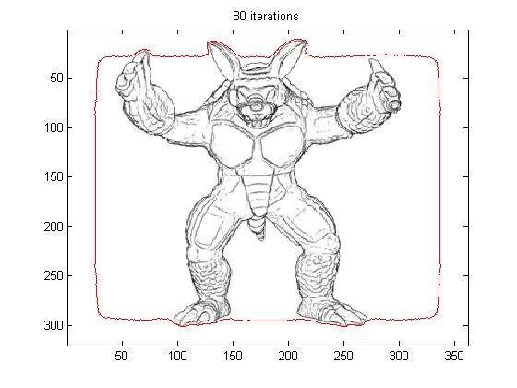
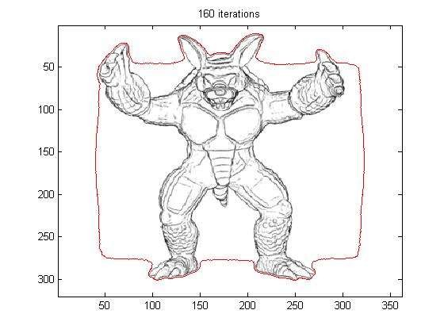
Contour Evolution Example

Slide 29
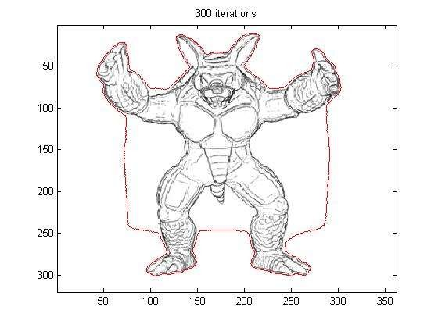
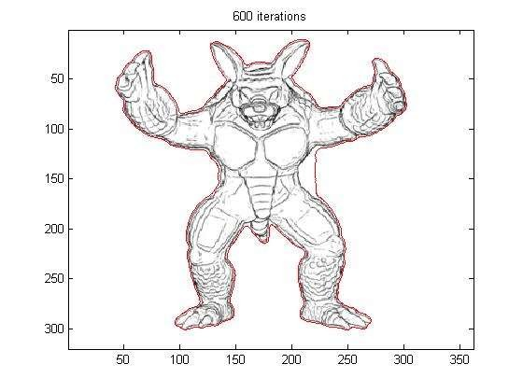
Contour Evolution Example

Slide 30
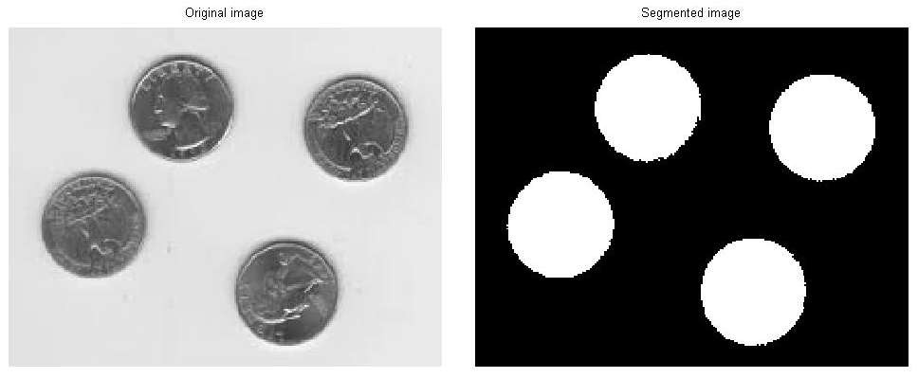
Results

Slide 31
Minimum spanning tree
Tree
Minimum spanning tree
Definition
Properties
Example
Applications

Slide 32
Tree
A tree is a graph with the following properties:
The graph is connected (can go from anywhere to anywhere)
There are no cycles(acyclic)
Tree
Graphs that are not trees

Slide 33

Watershed and Minimum Spanning Tree (MST)
Let G=(V,E) be an undirected connected graph.
A sub graph T=(V,E’) of G is a spanning tree of G iff T is a tree.
It is a tree (i.e., it is acyclic)
It covers all the vertices V
contains |V| - 1 edges
A single graph can have many different spanning trees.
4

Slide 34

Spanning trees
Connected undirected graph

Slide 35
A minimum cost spanning tree is a spanning tree which has a minimum total cost.
A minimum spanning tree (MST) or minimum weight spanning tree is then a spanning tree with weight less than or equal to the weight of every other spanning tree.
Addition of even one single edge results in the spanning tree losing its property of acyclicity and removal of one single edge results in its losing the property of connectivity.
It is the shortest spanning tree .
The length of a tree is equal to the sum of the length of the arcs on the
tree.

Slide 36
Properties
Possible multiplicity
There may be several minimum spanning trees of the same weight having a minimum number of edges
if all the edge weights of a given graph are the same, then every spanning tree of that graph is minimum.
If there are n vertices in the graph, then each tree has n-1 edges.
Uniqueness
If each edge has a distinct weight then there will be only one, unique minimum spanning tree.

Slide 37






Cycle Property:
Let T be a minimum spanning tree of a weighted graph G
Let e be an edge of G that is not in T and let C be the cycle formed by e with T
For every edge f of C, weight(f) ≤ weight(e)
If weight(f) > weight(e) we can get a spanning tree of smaller weight by replacing e with f
f
C
8
f
C
8
Replacing f with e
yields
a better spanning tree
4
4
9
3
9
3
2
6
2
6
e
e
7
8
7
8
7
7

Slide 38
Partition Property:
Consider a partition of the vertices of G into subsets U and V
Let e be an edge of minimum weight across the partition
There is a minimum spanning tree of G containing edge e
V
4
U
7
f
9
8
2
5
8
e
3
Proof:
Let T be an MST of G
If T does not contain e, consider the cycle C formed by e with T and let f be an edge of C across the partition
By the cycle property,
weight(f) ≤ weight(e)
Thus, weight(f) = weight(e)
We obtain another MST by replacing
f with e
7
Replacing f with e
yields
another MST
U
V
f
7
4
9
8
2
5
8
e
3
7

Slide 39

Minimum-cost spanning trees
If we have a connected undirected graph with a weight (or cost)
associated with each edge
The cost of a spanning tree would be the sum of the costs of its edges
A minimum-cost spanning tree is a spanning tree that has the lowest
cost
_{A} 16 _{B}
_{A} 16 _{B}
21 11
6
11
6
19
5
14
5
F
C
10
F C
33
_{E} 18 _{D}
A minimum-cost spanning tree
_{E} 18 _{D}
A connected, undirected graph

Slide 40

Applications of minimum spanning trees
Consider an application where n stations are to be linked using a communication network.
The laying of communication links between any two stations involves a
cost.
The problem is to obtain a network of communication links which while preserving the connectivity between stations does it with minimum cost.
The ideal solution to the problem would be to extract a sub graph termed minimum cost spanning tree.
It preserves the connectedness of the graph yields minimum cost.

Slide 41
Applications
Suppose you want to supply a set of houses with:
electric power
water
sewage lines
telephone lines
To keep costs down, you could connect these houses with a spanning tree ( for example, power lines)
However, the houses are not all equal distances apart
To reduce costs even further, you could connect the houses with a minimum-cost spanning tree

Slide 42
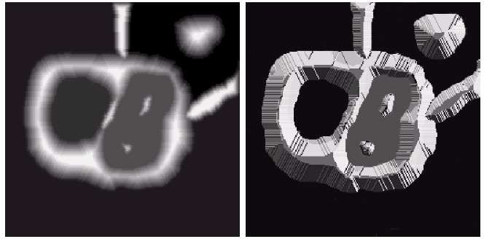
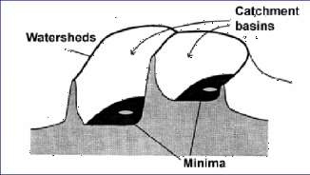
Watershed Segmentation Algorithm
Visualize an image in 3D: spatial coordinates and gray levels.
In such a topographic interpretation, there are 3 types of points:
Points belonging to a regional minimum
Points at which a drop of water would fall to a single minimum. (→The catchment basin or watershed of that minimum.)
Points at which a drop of water would be equally likely to fall to more than one minimum. (→The divide lines or watershed lines.)
Watershed lines

Slide 43
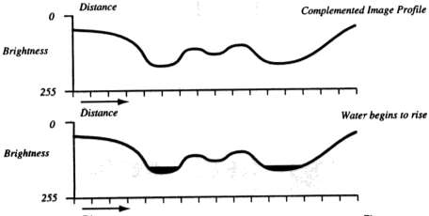
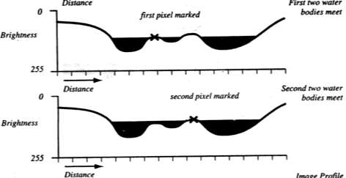
Watershed Segmentation Algorithm
The objective is to find watershed lines.
The idea is simple:
Suppose that a hole is punched in each regional minimum and that the entire topography is flooded from below by letting water rise through the holes at a uniform rate.
When rising water in distinct catchment basins is about the merge, a dam is built to prevent merging. These dam boundaries correspond to the watershed lines.

Slide 44
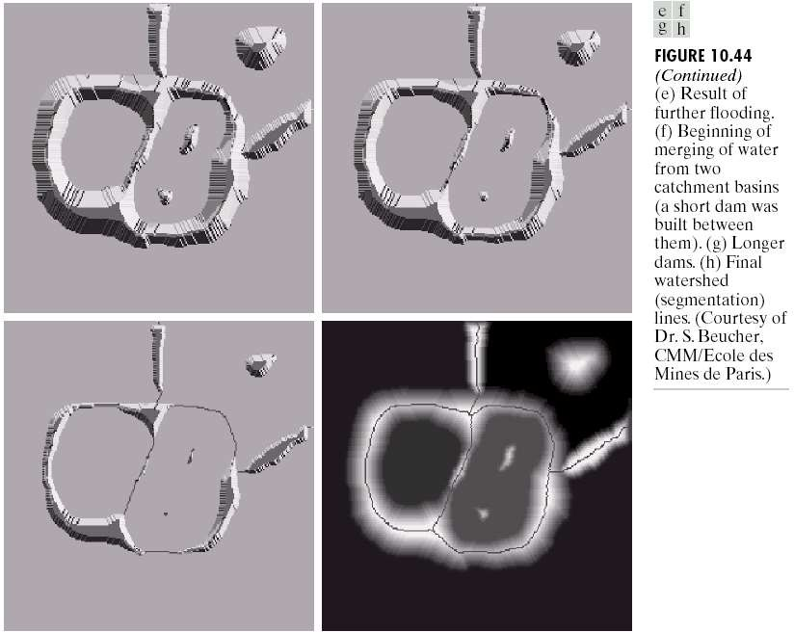
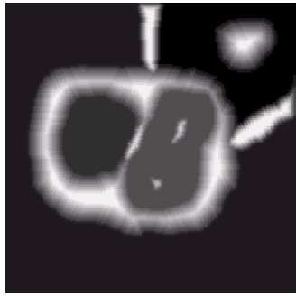
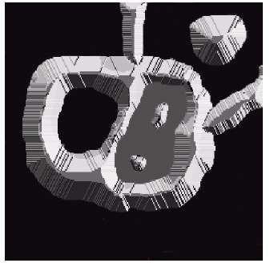
Watershed Segmentation Algorithm

Slide 45
Watershed Segmentation Algorithm
Start with all pixels with the lowest possible value.
These form the basis for initial watersheds
For each intensity level k:
For each group of pixels of intensity k
If adjacent to exactly one existing region, add these pixels to that
region
Else if adjacent to more than one existing regions, mark as boundary
Else start a new region

Slide 46
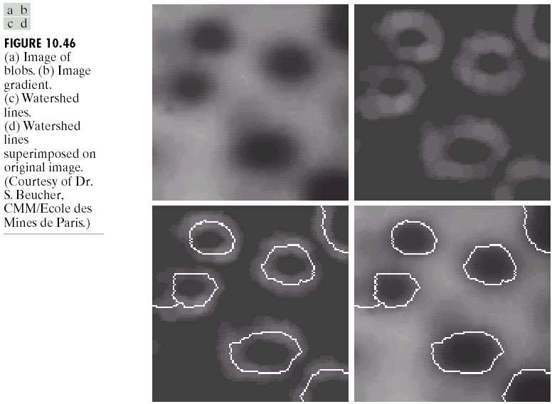
Watershed Segmentation Algorithm
Watershed algorithm might be used on the gradient image instead of the original image.

Slide 47
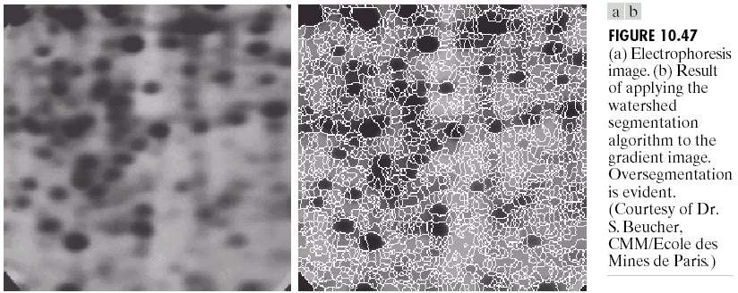
Watershed Segmentation Algorithm
Due to noise and other local irregularities of the gradient, oversegmentation might occur.

Slide 48
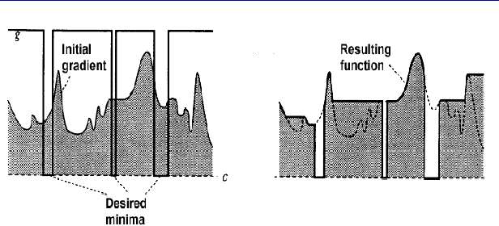
Watershed Segmentation Algorithm
A solution is to limit the number of regional minima. Use markers to specify the only allowed regional minima.

Slide 49
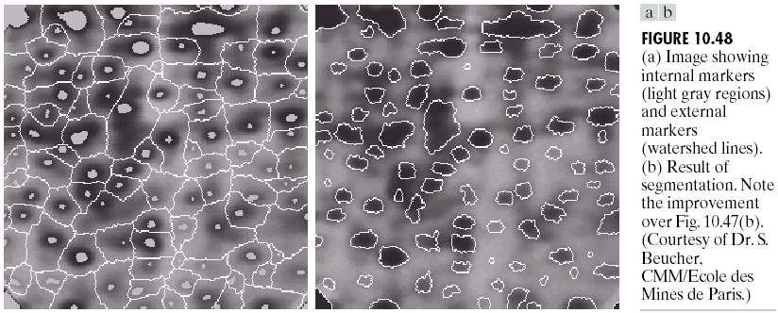
Watershed Segmentation Algorithm
A solution is to limit the number of regional minima. Use markers to specify the only allowed regional minima. (For example, gray-level values might be used as a marker.)

Slide 50
Livewire
Livewire, is a segmentation technique which allows a user to select regions of interest to be extracted quickly and accurately, using simple mouse clicks.
It is based on the lowest cost path algorithm, by Edsger W. Dijkstra. Firstly convolve the image with a Sobel filter to extract edges.
Each pixel of the resulting image is a vertex of the graph and has edges going to the 4 pixels around it, as up, down, left, right.
The edge costs are defined based on a cost function.

Slide 51
Livewire segmentation
The user sets the starting point clicking on an image's pixel, known as an anchor.
Then, as he starts to move the mouse over other points, the smallest cost path is drawn from the anchor to the pixel where the mouse is over, changing itself if the user moves the mouse.
If he wants to choose the path that is being displayed, he simply clicks the image again.
One can easily see in the right image, that the places where the user clicked to outline the desired region of interest are marked with a small square.
It is also easy to see that the livewire has snapped on the image's borders.

Slide 52
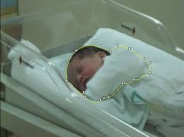
Livewire segmentation

Slide 53
Livewire algorithm
Convolve the image with a Sobel filter to extract edges.
Using this filtered image create a graph using pixels as nodes with edges in four directions (up, down, left right).
Edges are weighted with features gathered from the Sobel filter making it less costly to stay on an edge.
Several different cost methods are possible but the most important is the gradient magnitude

Slide 54
Algorithm Livewire
input:
s {Start (or seed) pixel.}
l(q, r) {Local cost function for link between pixels q and r.}
data structures:
L {List of active pixels sorted by total cost (initially empty).}
N(q) {Neighborhood set of q (contains 8 neighbors of pixel).}
e(q) {Boolean function indicating if q has been expanded/processed.}
g(q) {Total cost function from seed point to q.}
output:
p {Pointers from each pixel indicating the minimum cost path.}

Slide 55
Intelligent Scissors
a new, interactive tool called Intelligent Scissors which we use for image segmentation.
Fully automated segmentation is an unsolved problem, while manual tracing is inaccurate and laboriously unacceptable.
However, Intelligent Scissors allow objects within digital images to be extracted quickly and accurately using simple gesture motions with a mouse.
When the gestured mouse position comes in proximity to an object edge, alive-wire boundary “snaps” to, and wraps around the object of interest

Slide 56
Live-wire boundary detection formulates boundary detection as an optimal path search in a weighted graph.
Optimal graph searching provides mathematically piece-wise optimal boundaries while greatly reducing sensitivity to local noise or other intervening structures.
Robustness is further enhanced with on-the-fly training.
which causes the boundary to adhere to the specific type of edge currently being followed, rather than simply the strongest edge in the neighborhood.
Boundary cooling automatically freezes unchanging segments and automates input of additional seed points

Slide 57
Need for Deformable Model
♦
Due to both the tremendous variability of object shapes and the variation in image quality, Image Segmentation becomes a difficult task.
♦
Problems do arise when medical images are corrupted with noise and the structure itself is not clearly or completely visible in the image.
♦
This may result in detecting erroneous object regions or boundaries, or failing to detect true ones when applying classical segmentation techniques such as edge detection and thresholding.
♦
To address these difﬁculties, deformable models have been extensively studied and widely used in medical image segmentation, with promising results.

Slide 58
What is Deformable Model??
♦
Deformable models analyze those noisy images and provide a coherent representation for variable structure shapes.
♦
Deformable models are curves or surfaces defined within an image domain that can move under the influence of internal forces and external forces.
♦
Internal forces are defined within the curve or surface itself, and are designed to keep the model smooth during deformation.
♦
External forces, are computed from the image data and are defined to move the model toward an object boundary or other desired features within an image.

Slide 59
What is Deformable Model??
♦
They are designed to be attracted to external image features (such as edges) while maintaining internal shape constraints (such as smoothness).
♦
By constraining extracted boundaries to be smooth and incorporating other prior information about the object shape,
Deformable models offer:
- robustness to both image noise and boundary gaps.
♦
Deformable models allow integrating boundary elements into a coherent and consistent mathematical description readily available for subsequent applications.

Slide 60
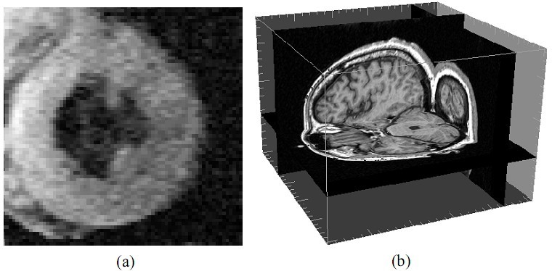
Image Segmentation Using Deformable Models
Fig: Variability of object shapes and imag equality. (a) A 2D MR image of the heart
left ventricle and (b) a 3D MR image of the brain.

Slide 61
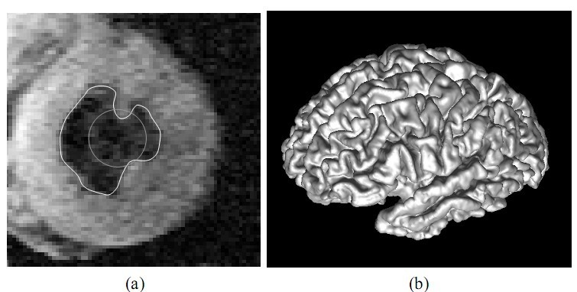
Image Segmentation Using Deformable Models
Fig: Examples of using deformable models to extract object boundaries from medical images. (a) An example of using a deformable contour to extract the in er wal of the ventricle of a human heart from a 2D MRimage. (b) (b)An example of using
a deformable surface to reconstruct the brain cortical surface from a 3D MRimage

Slide 62
Types of Deformable Model
♦
There are basically two types of deformable models depending on how the model is deﬁned in the shape domain.:
a) parametric deformable models Or active contours,
b) geometric deformable models Or implicit models.

Slide 63
Parametric Deformable Models
♦
Parametric deformable models or active contours were first introduced in 1988, by Kass et al., under the name “snakes” .
Snakes, use parametric curves to represent the model shape.
During their evolution, the deformations are determined by geometry, kinematics, dynamics etc.
♦
♦

Slide 64
Parametric Deformable Models
♦
Parametric deformable models represent curves and surfaces explicitly in their parametric forms during deformation.
♦
This representation allows direct interaction with the model and can lead to a compact representation for fast real-time implementation.
♦
The main advantage of parametric models is that they are usually very fast in their convergence, depending on the predetermined number of control points.
♦
Problem:
Adaptation of the model topology, such as splitting or merging
parts during the deformation, can be difﬁcult using parametric models i.e it is topology dependent.

Slide 65
Parametric Deformable Models
♦
Two different types of formulations for parametric deformable models:
an energy minimizing formulation and
a dynamic force formulation.
♦
The ﬁrst formulation has the advantage that its solution satisﬁes a minimum principle whereas the second formulation has the ﬂexibility of allowing the use of more general types of external forces.

